Slide 1
Advanced Renal Anatomy
Foundation of Nephrology
A Comprehensive Guide for Nephrology Fellows
Kidney-Hub

Slide 2
Learning Objectives
By the end of this presentation, nephrology fellows will have mastered the essential anatomical foundations required for clinical practice, procedural competence, and accurate diagnostic interpretation.
1
Gross Anatomy
Master kidney position, size, and anatomical relationships with surrounding structures
2
Internal Structure
Understand cortex, medulla, and pyelocalyceal collecting system organization
3
Nephron Anatomy
Comprehend functional unit components from glomerulus to collecting duct
4
Vascular Supply
Analyze arterial and venous systems including branching patterns and clinical significance
5
Clinical Correlations
Apply anatomical knowledge to variants, pathology, and surgical landmarks
Kidney-Hub

Slide 3
Gross Anatomy: Position and Dimensions
Position
Vertebral level:
T12 to L3
Location:
Retroperitoneal
Asymmetry:
Right kidney 1-2 cm lower (liver displacement)
Normal Dimensions
Length:
10-12 cm
Width:
5-7 cm
Thickness:
3-4 cm
Weight:
125-170 grams
Key Relationships
Superior:
Adrenal glands
Anterior (Right):
Liver, duodenum, colon
Anterior (Left):
Stomach, spleen, pancreas, colon
Posterior:
Diaphragm, psoas, quadratus lumborum, 12th rib
Clinical Pearl:
Kidney-Hub
Kidney length <9 cm suggests chronic kidney disease
NephroHub

Slide 4
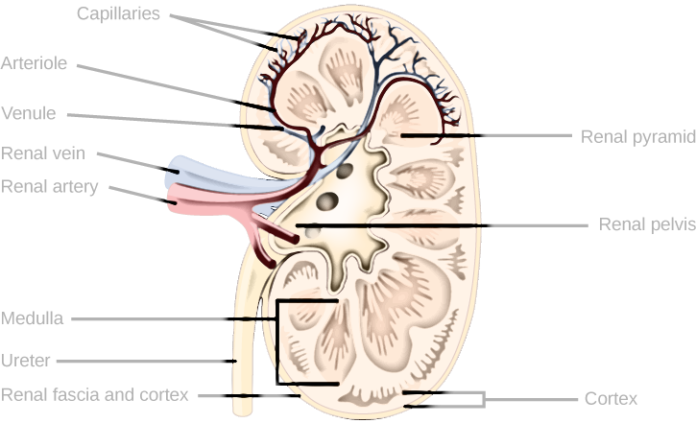
Internal Structure: Cortex and Medulla
Renal Cortex
Location:
Outer functional zone
Appearance:
Granular, reddish-brown (high blood flow)
Contains:
Glomeruli, proximal and distal convoluted tubules
Renal columns:
Cortical extensions between pyramids
(Columns of Bertin)
Renal Medulla
Organization:
8-18 renal pyramids (average 9 per kidney)
Appearance:
Striated, pale (lower blood flow)
Contains:
Loops of Henle, medullary collecting ducts
Papillae:
Pyramid apex (area cribrosa) drains into minor calyx
Renal Lobe Concept
One medullary pyramid plus its overlying cortex = one renal lobe (functional unit)
Clinical Significance:
Cortical thinning indicates chronic kidney disease.
Papillary necrosis seen in diabetes and analgesic nephropathy.
Kidney-Hub
NephroHub

Slide 5
Collecting System: Pyelocalyceal Anatomy
Hierarchical Organization
1. Renal Papilla
(Area cribrosa) → perforated tip of pyramid
2. Minor Calyces
→ 8-12 per kidney, cup-shaped structures
3. Major Calyces
→ 2-3 per kidney (upper, middle, lower
groups)
4. Renal Pelvis
→ intrarenal vs extrarenal types
5. Ureteropelvic Junction (UPJ)
→ transition to ureter
Clinical Applications
Stone Management
Calyceal anatomy guides percutaneous nephrolithotomy (PCNL) access planning
UPJ Obstruction
Narrowing at ureteropelvic junction causes hydronephrosis and flank pain
Infundibular Stenosis
Narrowing of calyceal neck traps stones, complicates endoscopic access
PCNL Access
Optimal trajectory through posterior calyx along Brödel's line minimizes bleeding
Kidney-Hub

Slide 6
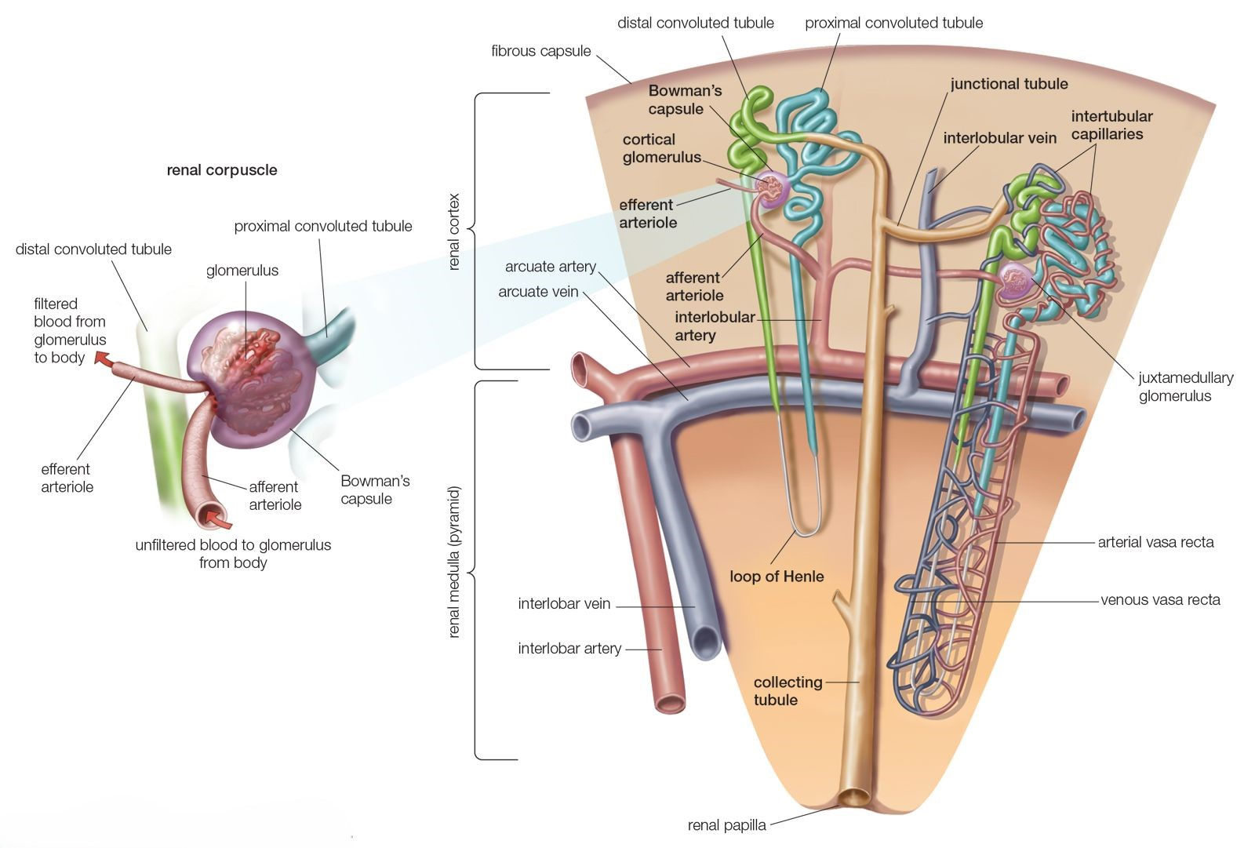
Nephron Anatomy: The Functional Unit
The nephron is the
irreplaceable functional unit
of the
kidney. Each kidney contains
1-2.5 million nephrons
that
cannot regenerate once lost.
Classification
Cortical nephrons (85%):
Short loops of Henle in outer
cortex
Juxtamedullary nephrons (15%):
Long loops extending
deep into medulla, crucial for urine concentration
Five Main Components
1. Renal Corpuscle:
Glomerulus + Bowman's capsule (filtration)
2. Proximal Tubule:
PCT and PST (65% reabsorption)
3. Loop of Henle:
Descending, thin ascending, thick
ascending/TAL
4. Distal Tubule:
DST and DCT (thiazide site)
5. Collecting Duct:
Connecting tubule → cortical → medullary
→ papillary duct
Clinical Pearl:
Nephron loss is irreversible and leads to
compensatory hyperfiltration in remaining nephrons
Kidney-Hub
NephroHub

Slide 7
Glomerular Filtration Barrier
A sophisticated three-layer biological filter that permits selective passage based on size and charge.
1. Fenestrated Endothelium
70-100 nm pores, negatively charged glycocalyx
2. Glomerular Basement Membrane
300-350 nm thickness, Type IV collagen, heparan sulfate proteoglycans
3. Podocyte Layer
Foot processes, 40 nm slit diaphragm (nephrin, podocin, CD2AP)
Filtration Selectivity
Size barrier:
Molecules >70 kDa restricted
Charge barrier:
Negative molecules repelled → Albumin (69 kDa,
negative) normally excluded
Clinical Diseases
Minimal change:
Podocyte foot process effacement
Alport syndrome:
GBM collagen IV mutations
Diabetic nephropathy:
GBM thickening
Anti-GBM disease:
Autoantibodies vs collagen IV
Kidney-Hub

Slide 8
Arterial Supply: Renal Arteries and Branching
The renal arterial system delivers
20-25% of cardiac output
to
the kidneys.
Hierarchical Branching
Renal Arteries
Origin from aorta at L1/L2, 4-6 cm length, 5-6 mm diameter. Right
artery passes posterior to IVC.
Main Divisions at Hilum
Anterior division (75%)
: apical, upper, middle, lower segmental
Posterior division (25%)
: posterior segmental
Intrarenal Cascade
Segmental → Lobar → Interlobar → Arcuate → Interlobular →
Afferent arterioles → Glomerular capillaries → Efferent arterioles →
Peritubular capillaries/vasa recta
Brödel's Avascular Line
Relatively avascular plane at
posterolateral border
between anterior
(75%) and posterior (25%) territories. Surgical landmark for
pyelolithotomy and partial nephrectomy.
Clinical Significance:
End-artery system with no collaterals
Arterial occlusion leads to infarction. Accessory renal arteries in 30% must be preserved during surgery.
Kidney-Hub
NephroHub

Slide 9
Venous Drainage: Renal Veins
The renal venous system differs from the arterial system by
possessing
extensive free anastomoses
, permitting safe ligation
of branches.
Right Renal Vein
Length:
2-2.5 cm (shorter than left)
Course:
Anterior-superior to lateral IVC
Tributaries:
Usually none (drains kidney only)
Left Renal Vein
Length:
8.5 cm average (3-4× longer than right)
Course:
Transverse, crosses anterior to aorta, inferior to SMA
Tributaries:
• Left adrenal vein (superior)
• Left gonadal vein (inferior)
• Left inferior phrenic vein (superior)
• Posterior lumbar veins (75%)
Clinical Significance
• Left kidney preferred for transplant (longer vein)
• Left gonadal drainage explains 93% left-sided varicocele
• Venous branches safely ligated due to collaterals
• LRV compression causes nutcracker syndrome
Kidney-Hub
NephroHub

Slide 10
Clinical Correlations: Vascular Variants
Anatomical variations in renal vasculature are
common (30% of patients)
rather than exceptional. Recognizing these
variants is essential for safe surgical intervention and accurate imaging interpretation.
Arterial Variants
Venous Variants
Accessory Renal Arteries
Circumaortic Left Renal Vein
Prevalence:
25-30% of population
Prevalence:
1.5-8.7%
Origin:
Usually from aorta (T11-L4 level) or iliac arteries
Anatomy:
Anterior and posterior branches encircle aorta
Clinical impact:
Lower pole accessory arteries can cause UPJ
Retro-aortic Left Renal Vein
obstruction (crossing vessel)
Prevalence:
2-3%
Surgical note:
Must be preserved in transplant and partial
nephrectomy
Course:
Posterior to aorta, drains into IVC at lower level (L3-
L4)
Early Branching
Risk:
Posterior nutcracker syndrome (compression between
Segmental arteries arise directly from aorta, complicates transplant harvesting
aorta and vertebra)
Multiple Renal Veins
Congenital Anomalies
Horseshoe Kidney
Prevalence:
15-30%, usually right-sided
Prevalence 1 in 400, lower position (L3-L4), multiple renal arteries common
Clinical Pearl
Always obtain preoperative CT angiography
Pelvic Kidney
to identify vascular variants before renal surgery or intervention.
Failure to recognize accessory vessels can lead to ischemia or hemorrhage.
Supplied by iliac arteries, multiple vessels common
Kidney-Hub
NephroHub

Slide 11
Clinical Correlations: Renovascular Pathology (Part 1)
Vascular pathology affecting the kidneys requires integrating anatomical knowledge with pathophysiological mechanisms for accurate diagnosis and management.
Renal Artery Stenosis (RAS)
Causes
Atherosclerosis (90%):
Affects proximal third of renal artery, typically in patients age >50 years, often bilateral
presentation
Fibromuscular dysplasia (10%):
Affects distal two-thirds, predominantly in young women, characteristic "string of
beads" appearance on angiography
Pathophysiology
Reduced renal perfusion → RAAS activation → renovascular hypertension. Bilateral or solitary kidney RAS → ischemic nephropathy → progressive chronic kidney disease
Clinical Presentation
Resistant hypertension, abdominal bruit, flash pulmonary edema, asymmetric kidney size on imaging, acute creatinine rise with ACE inhibitors or ARBs
Diagnostic Approaches
Doppler ultrasound:
Resistive index (RI) >0.8 suggests RAS
CT/MR angiography:
Non-invasive visualization of renal arteries
Renal arteriography:
Gold standard for diagnosis and intervention
Clinical Pearl:
Consider renal artery stenosis in patients with resistant hypertension, especially when
accompanied by asymmetric kidney sizes or acute creatinine rise following initiation of ACE inhibitors or ARBs.
Kidney-Hub
NephroHub

Slide 12
Clinical Correlations: Renovascular Pathology (Part 2)
Nutcracker Syndrome
Renal Infarction
Anatomy
Causes
Anterior (most common):
LRV compressed between aorta
Thromboembolism (AF, endocarditis), in situ thrombosis, renal artery dissection, iatrogenic
and SMA
Posterior:
Retro-aortic LRV compressed between aorta and
Presentation
vertebra
Acute flank pain, fever, hematuria, elevated LDH (disproportionate to creatinine)
Clinical Features
Left flank pain, hematuria, orthostatic proteinuria, left varicocele (males), pelvic congestion (females)
Diagnosis
CT angiography (wedge-shaped perfusion defect, cortical rim sign)
Diagnosis
Doppler US (velocity ratio >5), CT/MR venography (beak sign), pressure gradient >3 mmHg
Clinical Pearl:
High index of suspicion needed for renal
Treatment
infarction in patients with AF or recent cardiac
Conservative observation, endovascular stenting, surgical transposition, renal autotransplantation
procedures presenting with acute flank pain and
elevated LDH
Kidney-Hub

Slide 13
Clinical Correlations: Surgical Landmarks
Brödel's Avascular Line
Renal Biopsy Approach
Location:
Posterolateral border, junction of anterior (75%)
Standard Approach:
Posterolateral, lower pole
and posterior (25%) vascular territories
Position:
Prone or lateral decubitus
Use:
Pyelolithotomy, partial nephrectomy incision plane
Target:
Outer cortex (avoid medulla to minimize bleeding)
Caution:
Not truly avascular; requires hemostasis
Depth:
1.5-2 cm from capsule
PCNL Access Points
Contraindications:
Uncontrolled HTN, bleeding diathesis,
solitary kidney (relative), hydronephrosis
Upper Pole:
Above 12th rib (pleural risk)
Transplant Anatomy
Lower Pole:
Below 12th rib (safest, limited reach)
Optimal Trajectory:
Through calyx along Brödel's line to
Donor Selection:
Left kidney preferred (longer vein: 8.5
avoid major vessels
cm vs 2.5 cm)
Imaging:
Fluoroscopy/ultrasound guidance essential
Recipient Site:
Right iliac fossa (most common)
Vascular Anastomosis:
Renal artery → external iliac
artery; Renal vein → external iliac vein
Ureter:
Ureteroneocystostomy with anti-reflux tunnel
Kidney-Hub
Accessory Vessels:
Must be preserved or reconstructed
Clinical Pearl:
Preoperative CT angiography essential
for all renal procedures to identify vascular variants
NephroHub

Slide 14
Summary: Key Takeaways
Gross Anatomy
Vascular Supply
• T12-L3 retroperitoneal position, right kidney lower
• Arterial: end-artery system (no collaterals) → infarction risk
• Normal length 10-12 cm; <9 cm suggests CKD
• Brödel's line: posterolateral avascular plane (surgical landmark)
• Anterior relations differ between sides
• Venous: free anastomoses (safe to ligate branches)
Internal Structure
• Left renal vein 8.5 cm (right 2.5 cm) → transplant preference
• Cortex: granular, contains glomeruli and tubules
Clinical Correlations
• Medulla: 8-18 pyramids, loops of Henle
• Collecting system: papilla → minor calyx → major calyx → pelvis → ureter
• Accessory renal arteries in 25-30% (must preserve)
• Renal artery stenosis → renovascular hypertension
• Nutcracker syndrome: LRV compression (hematuria, varicocele)
Nephron Anatomy
• 1-2.5 million nephrons per kidney (irreplaceable)
• Preoperative CT angiography essential for surgical planning
• Glomerular filtration barrier: 3 layers (endothelium, GBM, podocytes)
Key Takeaway
• Proximal tubule reabsorbs 65% of filtrate
• Loop of Henle creates medullary osmotic gradient
Comprehensive understanding of renal anatomy integrates gross structure, microscopic organization, vascular supply, and clinical variants to form the foundation for safe procedural interventions and accurate diagnosis in nephrology practice.
Kidney-Hub
NephroHub

Slide 15
Assessment: Review Questions
Assessment: Review Questions
1. What is the normal vertebral level range for kidney position?
4. Describe the anatomy and clinical presentation of nutcracker syndrome.
1. What is the normal vertebral level range for kidney position?
4. Describe the anatomy and clinical presentation of nutcracker syndrome.
Answer:
T12 to L3, with the right kidney positioned 1-2 cm
Answer:
Compression of the left renal vein between the
lower than the left due to liver displacement.
aorta and superior mesenteric artery (anterior type) or
Answer:
T12 to L3, with the right kidney positioned 1-2 cm
Answer:
Compression of the left renal vein between the
2. What is Brödel's avascular line and why is it clinically important?
between aorta and vertebra (posterior type). Presents with
lower than the left due to liver displacement.
aorta and superior mesenteric artery (anterior type) or
left flank pain, hematuria, orthostatic proteinuria, and left
between aorta and vertebra (posterior type). Presents with
2. What is Brödel's avascular line and why is it clinically important?
varicocele in males.
Answer:
A relatively avascular posterolateral plane between
left flank pain, hematuria, orthostatic proteinuria, and left
5. What is the fundamental difference between renal arterial and venous systems?
anterior (75%) and posterior (25%) vascular territories. Used
varicocele in males.
as surgical landmark for pyelolithotomy and partial
Answer:
A relatively avascular posterolateral plane between
5. What is the fundamental difference between renal arterial and venous systems?
nephrectomy to minimize bleeding.
Answer:
Arterial system is an end-artery system with no
anterior (75%) and posterior (25%) vascular territories. Used
as surgical landmark for pyelolithotomy and partial
collaterals (occlusion causes infarction), while venous system
3. Why is the left kidney preferred for transplantation?
has extensive free anastomoses (branches can be safely
nephrectomy to minimize bleeding.
Answer:
Arterial system is an end-artery system with no
ligated without parenchymal damage).
collaterals (occlusion causes infarction), while venous system
3. Why is the left kidney preferred for transplantation?
has extensive free anastomoses (branches can be safely
Answer:
The left renal vein is significantly longer (8.5 cm)
6. Why are 93% of varicoceles left-sided?
compared to the right (2.5 cm), facilitating easier vascular
ligated without parenchymal damage).
anastomosis to the recipient's iliac vessels.
Answer:
The left gonadal vein drains into the left renal vein
Answer:
The left renal vein is significantly longer (8.5 cm)
6. Why are 93% of varicoceles left-sided?
compared to the right (2.5 cm), facilitating easier vascular
at a 90-degree angle (higher pressure), while the right
gonadal vein drains directly into the IVC at an acute angle
anastomosis to the recipient's iliac vessels.
Answer:
The left gonadal vein drains into the left renal vein
(lower pressure). This anatomical difference explains the left-
at a 90-degree angle (higher pressure), while the right
sided predominance.
gonadal vein drains directly into the IVC at an acute angle
Kidney-Hub
(lower pressure). This anatomical difference explains the left-
sided predominance.

