Slide 1

Introduction to Nephrology
Understanding Kidney Structure, Function, and Disease

Slide 2

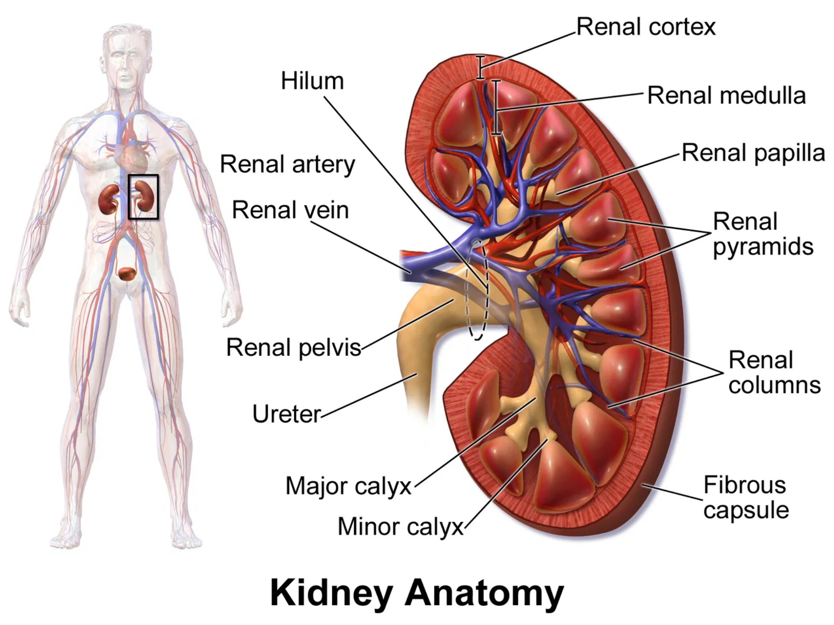
Kidney Anatomy and Structure
Location:
Pair of bean-shaped organs located on either side of the spine, below the ribcage in the retroperitoneal space.
Size:
Each kidney is approximately 10-12 cm long, 5-7 cm wide, and 3 cm thick, weighing about 150g.
Structure:
Divided into outer cortex and inner medulla. The medulla contains renal pyramids that drain into calyces, which connect to the renal pelvis.
Blood Supply:
Receives 20-25% of cardiac output via renal arteries, which branch into smaller vessels to supply nephrons.
Key Takeaways
The kidneys filter about 180 liters of blood daily
Each kidney contains approximately 1 million nephrons
The hilum is where blood vessels, nerves, and ureter enter/exit
Cross-sectional view of kidney showing major anatomical structures

Slide 3

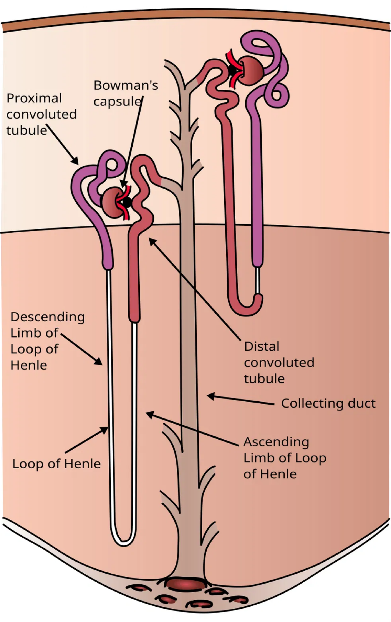

The Nephron: Functional Unit
The nephron is the microscopic functional unit of the kidney, with each kidney containing approximately 1 million nephrons.
Renal Corpuscle
Consists of the glomerulus and Bowman's capsule. Site of blood filtration.
Proximal Convoluted Tubule (PCT)
Reabsorbs ~65% of filtered water and sodium, glucose, amino acids, and bicarbonate.
Loop of Henle
Creates medullary concentration gradient essential for urine concentration.
Distal Convoluted Tubule (DCT)
Site of fine-tuning of electrolyte balance. Regulated by aldosterone.
Collecting Duct
Final site of water reabsorption, regulated by ADH. Controls urine concentration.
Key Takeaways
Two types: cortical (85%) and juxtamedullary (15%) nephrons
Processes 180L of filtrate daily, producing 1-2L of urine
Detailed structure of a nephron showing all major components

Slide 4

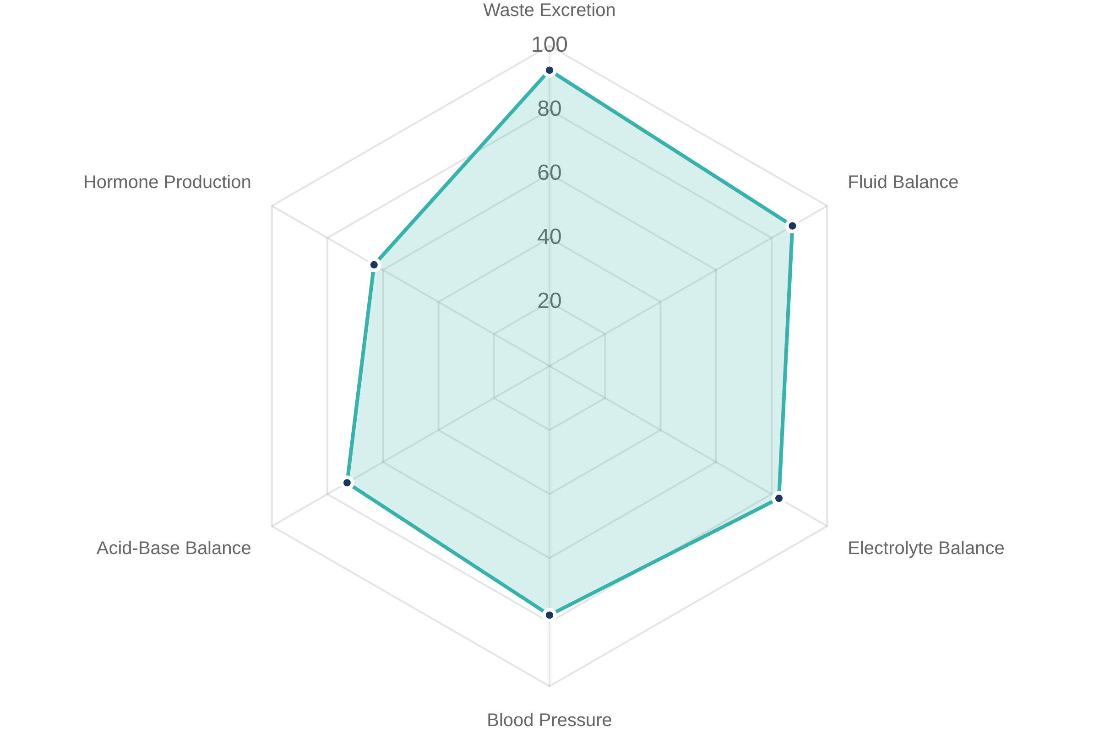
Basic Kidney Functions
Waste Excretion
Removal of metabolic waste products (urea, creatinine, uric acid) and toxins from the bloodstream.
Fluid & Electrolyte Balance
Regulation of water content and electrolytes (sodium, potassium, calcium, phosphate) to maintain homeostasis.
Blood Pressure Regulation
Control of blood pressure via the renin-angiotensin-aldosterone system (RAAS).
Acid-Base Balance
Maintenance of blood pH by excreting acids and reabsorbing bicarbonate.
Key Takeaways
Hormone Production
Kidneys filter about 180 liters of blood daily
Synthesis of erythropoietin (red blood cell production) and activation of vitamin D (calcium absorption).
Maintain homeostasis through multiple regulatory mechanisms
Dysfunction leads to systemic effects throughout the body

Slide 5

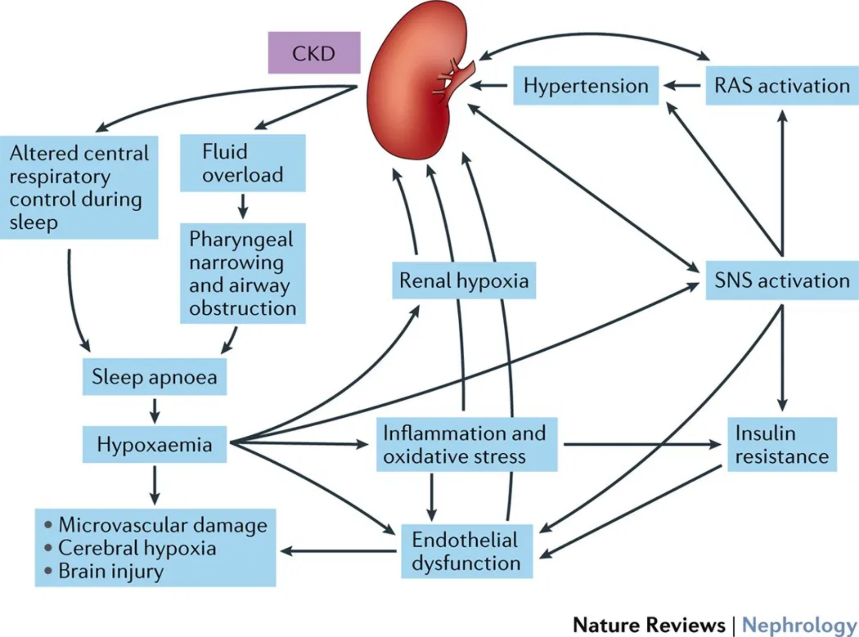
Pathophysiology of Common Kidney Diseases
Acute Kidney Injury (AKI)
Sudden decline in kidney function categorized as pre-renal (decreased perfusion), intrinsic (direct damage to kidney tissue), or post-renal (urinary tract obstruction).
Chronic Kidney Disease (CKD)
Progressive loss of kidney function over months or years. Common causes include diabetes, hypertension, and glomerulonephritis. Characterized by nephron loss and fibrosis.
Glomerular Diseases
Disorders affecting the glomeruli, including minimal change disease, focal segmental glomerulosclerosis, and membranous nephropathy. Often present with proteinuria.
Pathophysiological mechanisms in chronic kidney disease
Polycystic Kidney Disease
Key Takeaways
Genetic disorder characterized by development of multiple cysts in the kidneys, leading to kidney enlargement and progressive function decline.
Kidney diseases often have multifactorial pathogenesis
Progression involves common pathways of inflammation and fibrosis
Early detection and intervention can slow disease progression

Slide 6

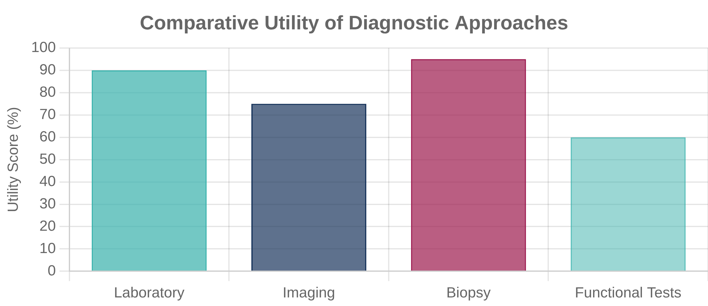
Diagnostic Approaches in Nephrology
Laboratory Tests
Specialized Procedures
Serum Creatinine & eGFR:
Kidney Biopsy:
Gold standard for diagnosing many kidney diseases
Primary markers for assessing kidney function
Nuclear Scans:
Assess kidney function and perfusion
Urinalysis:
Evaluates for proteinuria, hematuria, casts, and crystals
Angiography:
Evaluates renal vasculature
Urine Protein/Creatinine Ratio:
Quantifies proteinuria
Electrolytes & Acid-Base:
Assesses kidney's regulatory function
Imaging Studies
Ultrasound:
First-line imaging to assess kidney size and structure
CT Scan:
Detailed imaging for stones, masses, and vascular abnormalities
MRI:
Superior soft tissue contrast without radiation exposure
Key Takeaways
Comprehensive approach combining labs, imaging, and procedures is often necessary
Non-invasive tests should precede invasive procedures
Consider risk-benefit ratio for contrast studies in patients with impaired kidney function

Slide 7

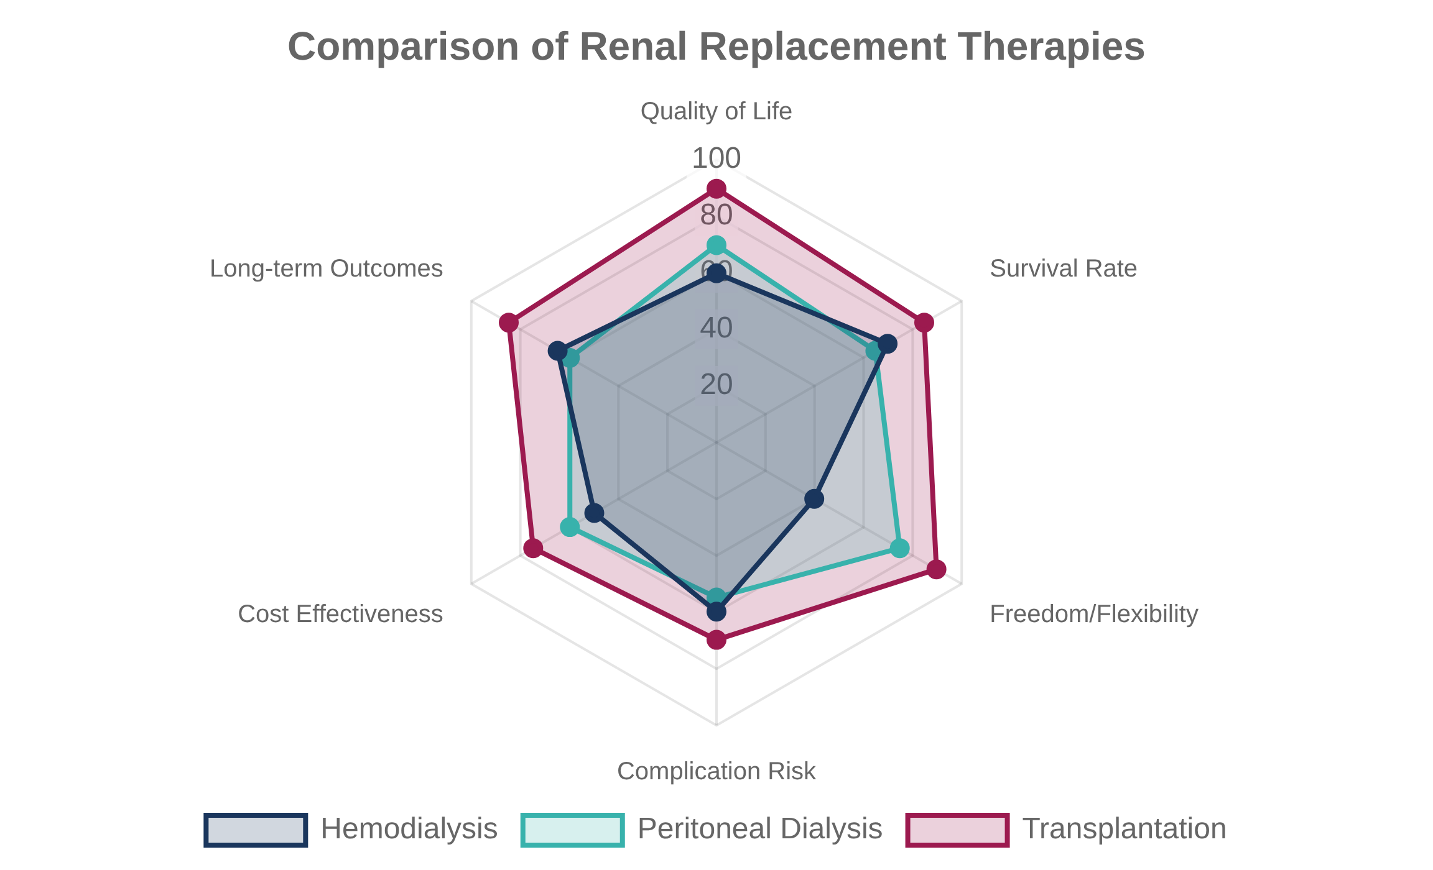
Treatment Options in Nephrology
Medical Management
Blood Pressure Control:
ACE inhibitors, ARBs, CCBs to slow CKD progression
Glycemic Control:
SGLT2 inhibitors show renoprotective effects in diabetic kidney disease
Dietary Modifications:
Sodium, potassium, phosphorus, and protein restrictions as needed
Anemia Management:
Erythropoiesis-stimulating agents and iron supplementation
Renal Replacement Therapy
Hemodialysis:
Blood filtration through an external dialyzer, typically 3 sessions/week
Peritoneal Dialysis:
Emerging Therapies
Uses peritoneum as natural filter, offering more independence
Novel Pharmaceuticals:
Kidney Transplantation:
Endothelin receptor antagonists, HIF stabilizers, anti-fibrotics
Optimal treatment for ESRD, from living or deceased donors
Key Takeaways
Wearable Artificial Kidney:
Portable dialysis technology in development
Regenerative Medicine:
Stem cell therapies and bioengineered kidneys
Treatment approach should be individualized based on disease etiology and stage
Early intervention can significantly slow CKD progression
Multidisciplinary care improves outcomes in kidney disease

