Slide 1

KIDNEY HUB · CHAPTER 12
Hypertension-Associated Kidney Disease
Diagnostic and management essentials for medical residents
A practical framework for recognizing phenotype, red flags, emergencies, and kidney-protective care

Slide 2
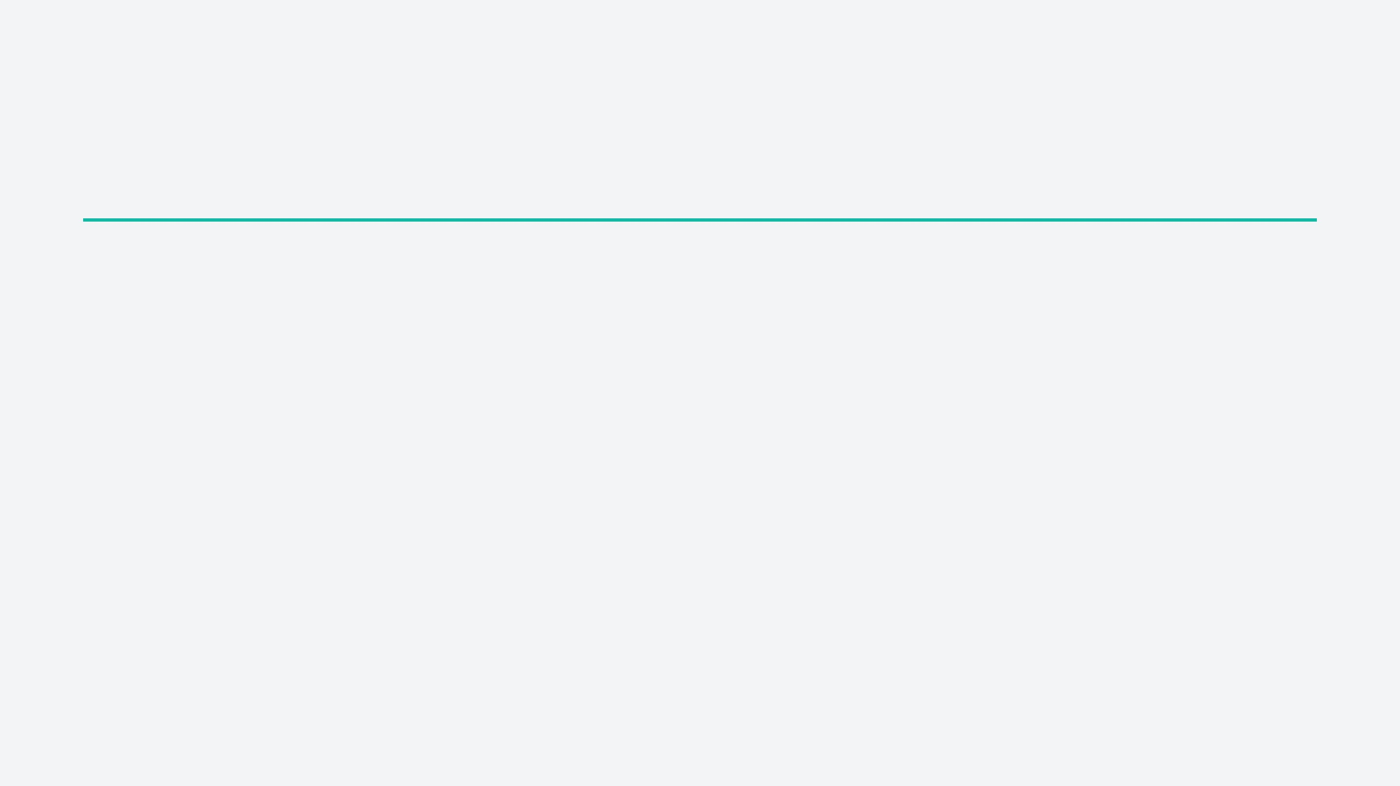
01 · DIAGNOSTIC FRAME
Hypertension + CKD does not prove causality
“Hypertensive nephrosclerosis” is a probability-based clinicopathologic hypothesis.
TYPICAL PATTERN
Long duration: years of hypertension
Trajectory: slowly declining eGFR
Use the label only after considering whether another disease better explains the kidney phenotype.
Urine: bland sediment, low-to-moderate albuminuria
Imaging: often small, symmetric kidneys

Slide 3

02 · FIRST-PASS WORKUP
Start with a structured kidney assessment
01
02
03
04
Confirm chronicity
Read the urine
Review context
Image selectively
Prior creatinine/eGFR, UACR, urinalysis, trajectory, and kidney size.
Quantify albuminuria; inspect for dysmorphic RBCs, casts, or active sediment.
Diabetes, drugs, NSAIDs, systemic symptoms, family history, APOL1 context, renovascular clues.
Ultrasound for size, obstruction, asymmetry, and structural clues; escalate when the phenotype is atypical.
The first question is not “Is the BP high?” but “Does the kidney phenotype fit the proposed cause?”

Slide 4

03 · DIAGNOSTIC SAFETY NET
Recognize the atypical phenotype
A change in urine phenotype changes the diagnosis.
01
02
Heavy proteinuria
Active sediment
Do not explain new kidney findings as “worsening hypertension” without reopening the differential.
Nephrotic-range or rapidly increasing albuminuria.
Dysmorphic RBCs, RBC casts, or new hematuria.
03
04
Rapid decline
Broader clues
Abrupt AKI or unexpectedly fast eGFR loss.
Systemic disease, asymmetry, monoclonal features, or renovascular signs.
Next: targeted serology, structural assessment, and biopsy consideration when it will change management.

Slide 5
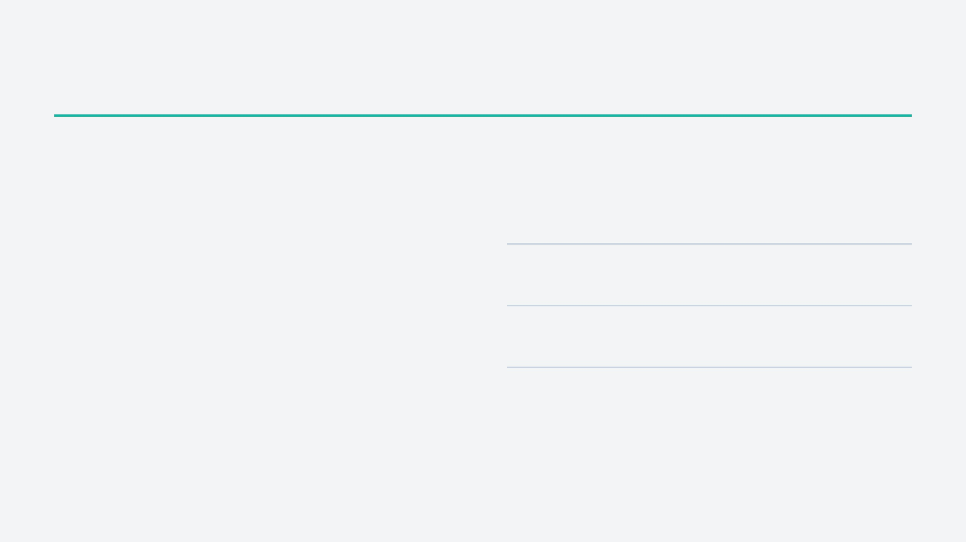
04 · BLOOD-PRESSURE PHENOTYPE
Measure blood pressure correctly
STANDARDIZED OFFICE TECHNIQUE
CHOOSE THE RIGHT MEASUREMENT
1
Rest:
seated, back supported, feet on the floor.
KDIGO: SBP <120 mmHg when standardized and tolerated.
2
Position:
correct cuff size; arm supported at heart
level.
3
Process:
no talking; repeat readings and document
Home BP
Structured repeated readings for day-to-day control.
the method.
4
Interpretation:
do not transfer targets from
ABPM
Unmasks nocturnal, masked, or reverse-dipping hypertension.
standardized to casual readings.
Orthostasis
Essential when dizziness, frailty, or aggressive treatment is present.
Resident move: confirm the phenotype before escalating therapy.

Slide 6
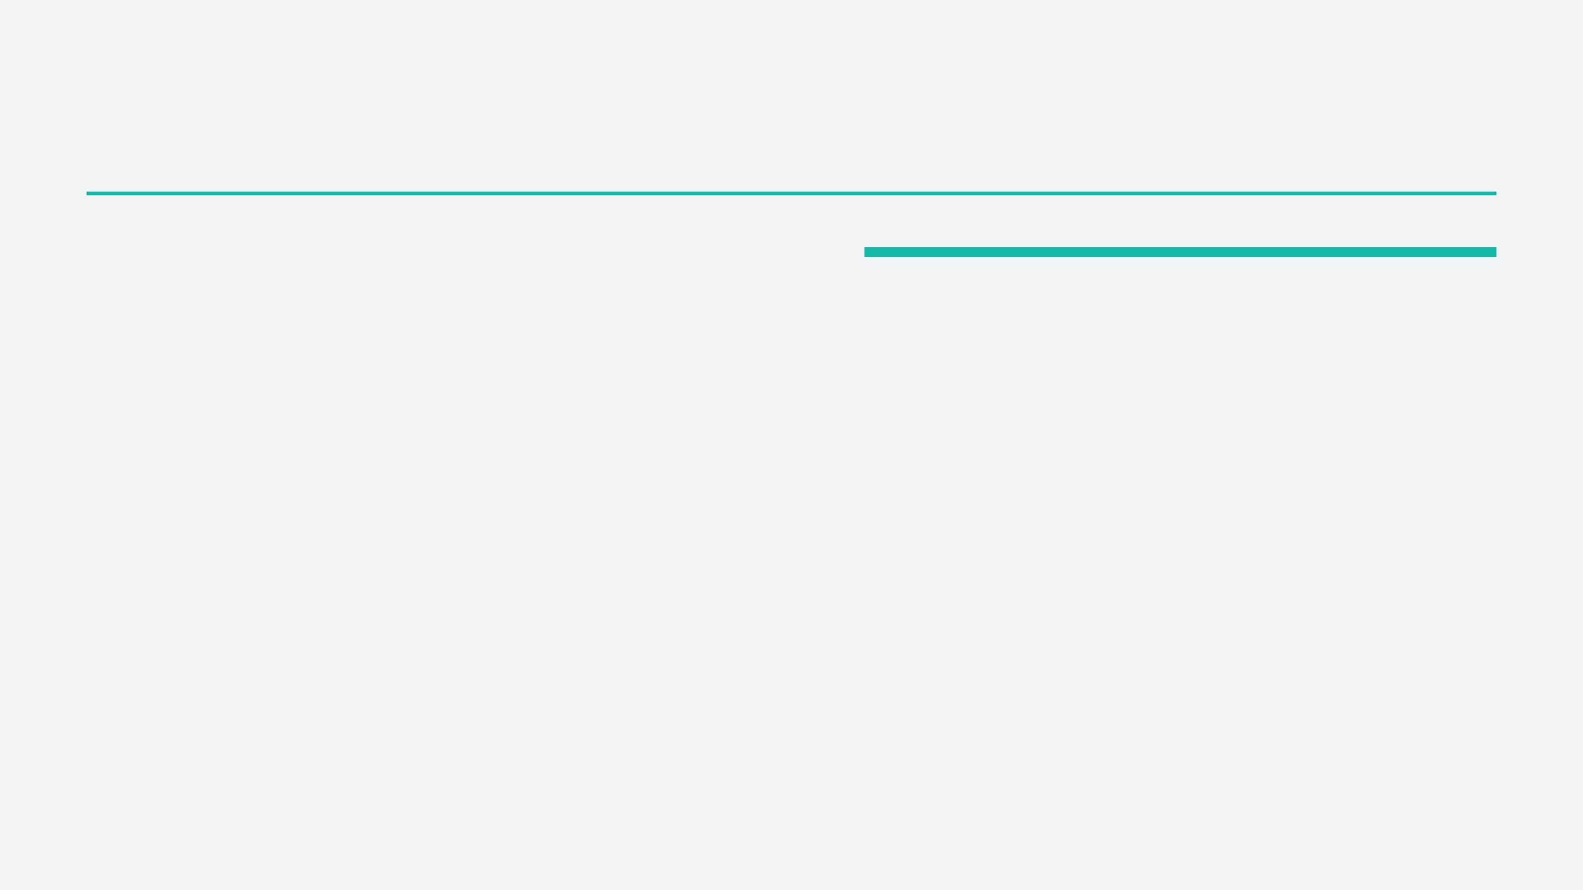
05 · KIDNEY PROTECTION
Connect BP phenotype to treatment
BUILD THE REGIMEN
01
Sodium and volume
MONITOR SAFELY
Assess dietary sodium, edema, congestion, orthostasis, adherence, and diuretic effect before simply adding drugs.
After RAAS initiation: recheck creatinine and potassium; investigate volume depletion, NSAIDs, obstruction, or renovascular disease if kidney function worsens.
02
Albuminuria matters
Use an ACE inhibitor or ARB when clinically indicated; the benefit is greatest when albuminuria is significant.
Avoid routine dual blockade: ACE inhibitor plus ARB increases AKI and hyperkalemia risk without routine added benefit.
03
Treat the whole risk
Pair BP control with cardiovascular-risk reduction, appropriate SGLT2 therapy, and medication stewardship.
Do not anchor on one number: interpret BP, kidney function, potassium, volume status, and symptoms together.
Safe kidney protection is a monitored process—not a prescription written once.

Slide 7
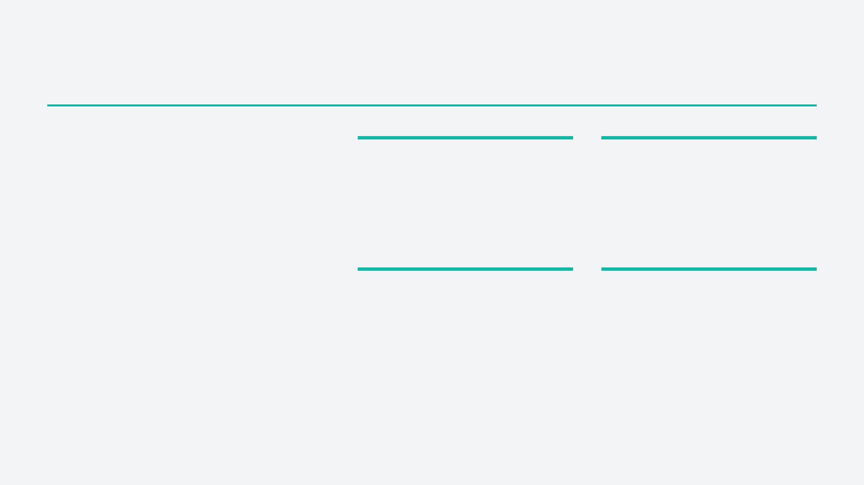
06 · KIDNEY PROTECTION
Add kidney-protective therapy safely
SGLT2
inhibitors
01
02
Confirm eligibility
Expect a dip
Use in eligible CKD populations for kidney and cardiovascular protection, according to current guidance.
A modest early eGFR fall can occur; a large or progressive decline needs reassessment.
BENEFIT + VIGILANCE
03
04
The early eGFR change is usually hemodynamic—but symptoms and context determine whether it is safe to continue.
Check volume
Prevent complications
Review BP, orthostasis, weight, intake, diuretics, and congestion before attributing symptoms to the drug.
Discuss sick-day and perioperative interruption, genital infection risk, and rare ketoacidosis risk.
Resident rule: do not reflexively stop therapy for a small eGFR dip; do not ignore hypotension, dehydration, or acute illness.

Slide 8
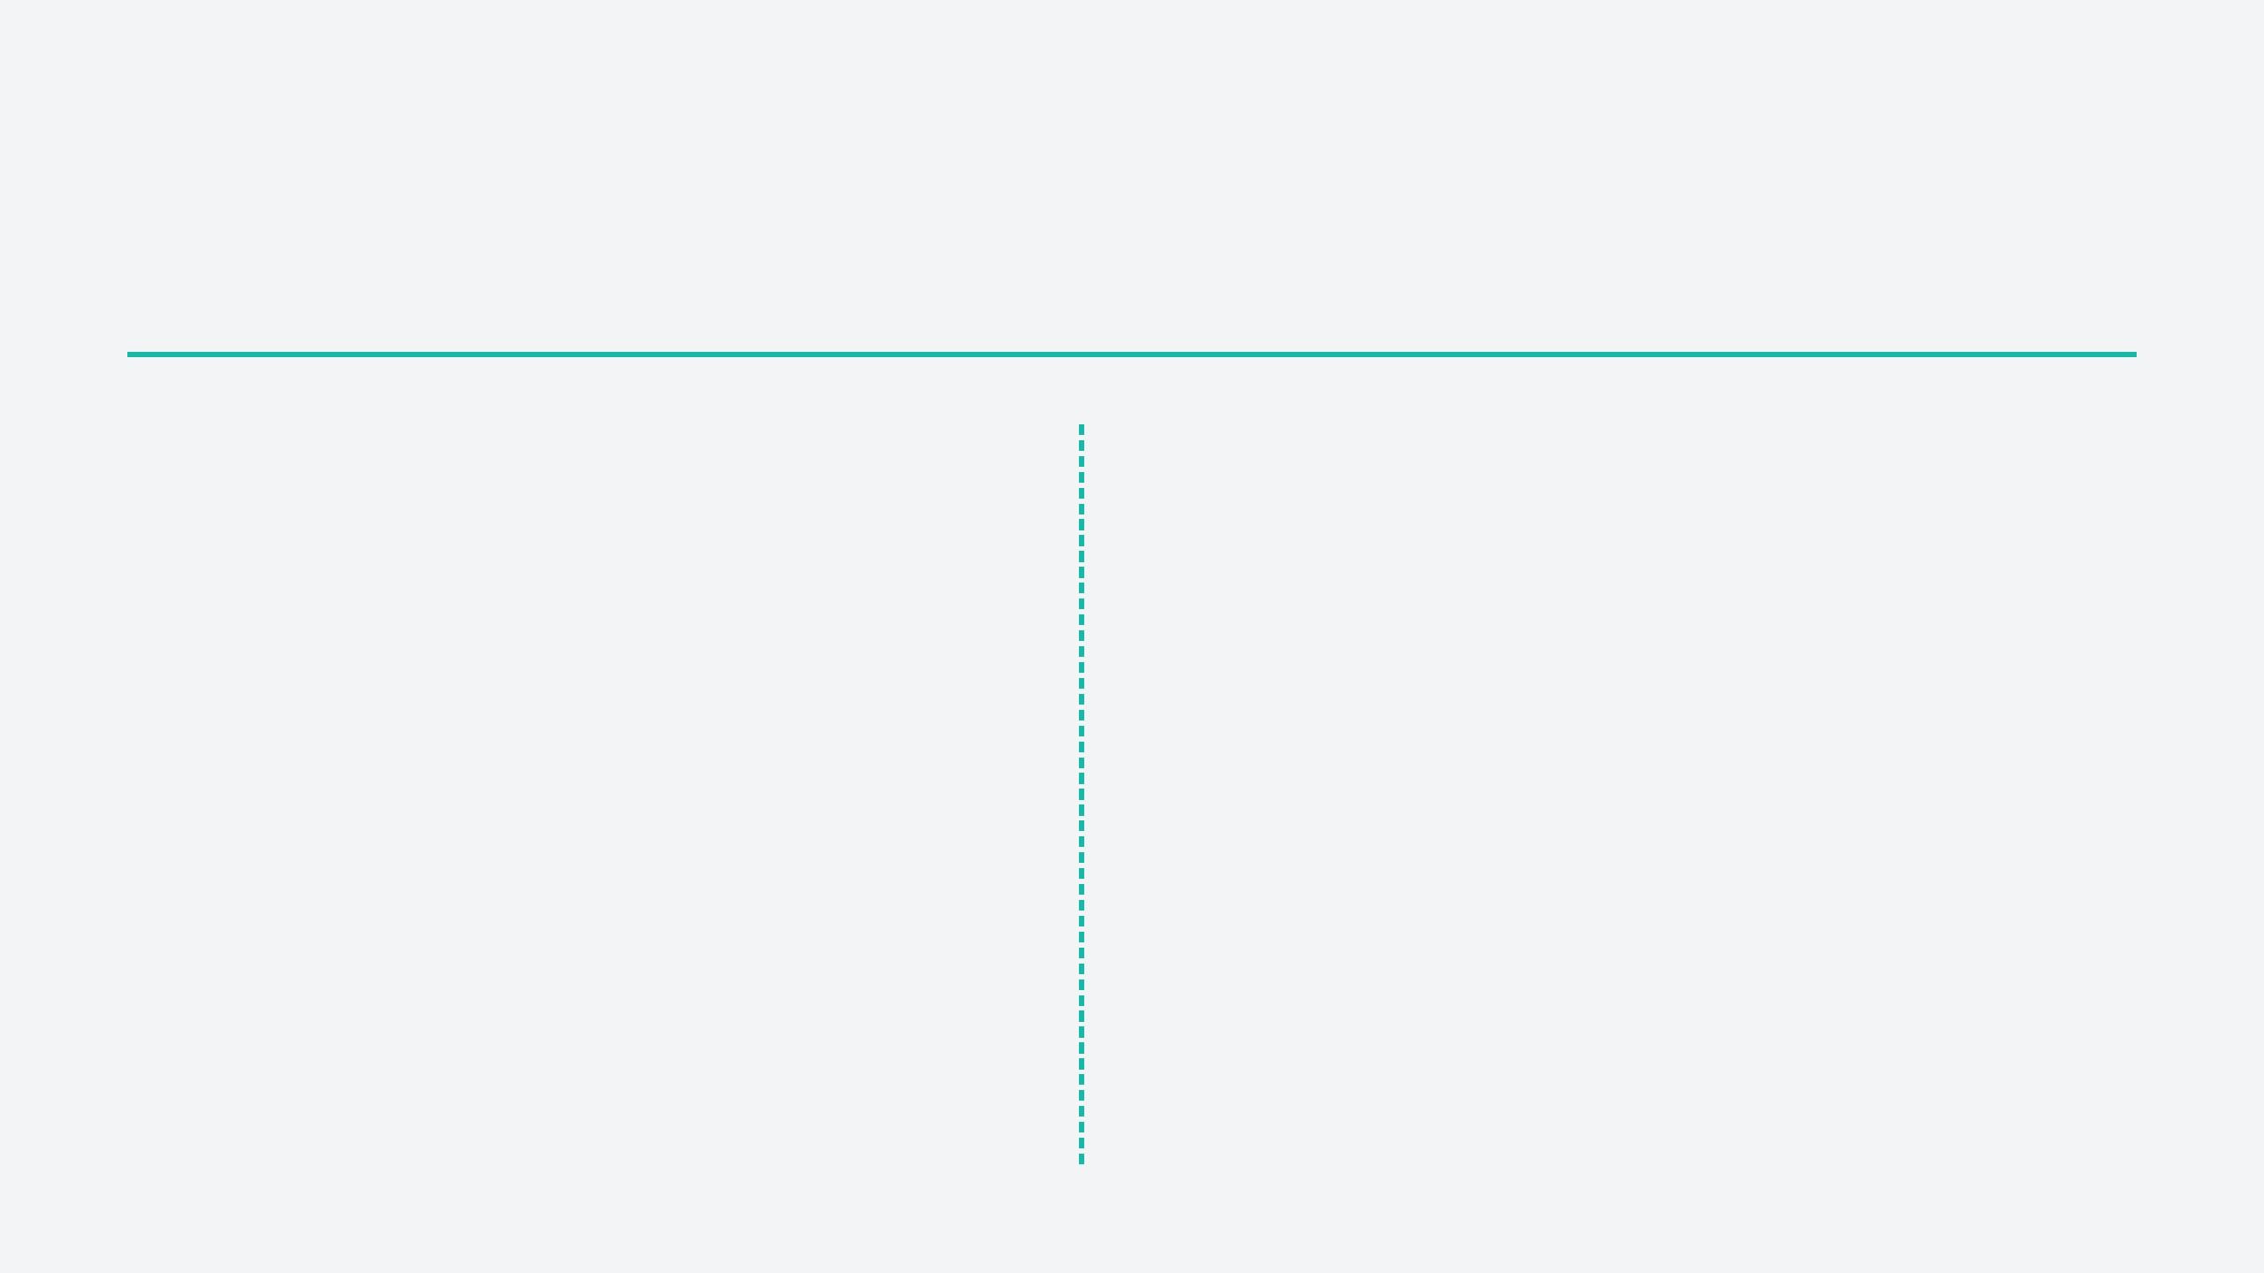
07 · HIGH-RISK BP PHENOTYPE
Resistant hypertension and emergencies require different first moves
IF BP REMAINS HIGH
IF TARGET-ORGAN INJURY IS PRESENT
Confirm true resistance before adding drugs.
Treat hypertensive emergency now.
Red flags: encephalopathy, pulmonary edema, AKI, retinal injury, myocardial injury, or TMA.
1 · Confirm: standardized or out-of-office measurements, adherence, and sodium intake.
Immediate: monitored care, organ support, and controlled reduction with titratable therapy when indicated.
2 · Remove: NSAIDs, stimulants, oral contraceptives, excess alcohol, and other interfering agents.
Evaluate in parallel: schistocytes, thrombocytopenia, hemolysis, TTP, complement-mediated TMA, drugs, pregnancy-related disease.
3 · Look for: volume excess, sleep apnea, primary aldosteronism, renal artery disease, and endocrine causes.
Do not delay: stabilization must come before biopsy or extensive etiologic workup.
4 · Clue: hypokalemia plus metabolic alkalosis suggests primary aldosteronism.
Severe BP alone is not the syndrome; severe BP plus acute target-organ injury is.

Slide 9
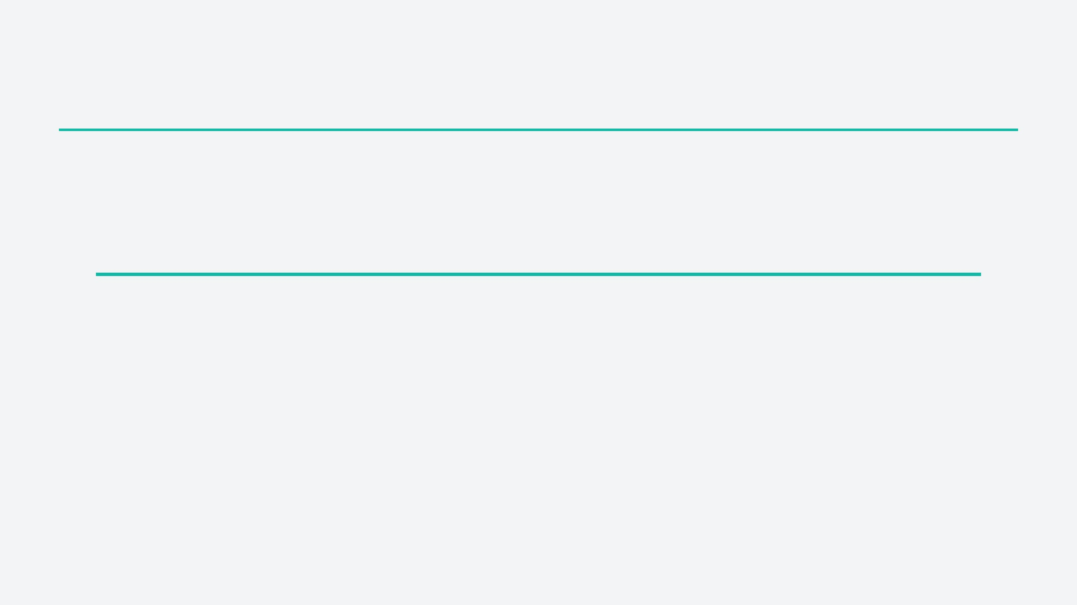
08 · LONGITUDINAL CKD CARE
Plan early for kidney failure
Start the conversation before a crisis. Use risk and patient goals to guide timing—not a single eGFR threshold.
01
02
03
04
Recognize risk
Share decisions
Prepare options
Start when indicated
Track eGFR slope, albuminuria, comorbidity, frailty, symptoms, and validated kidney-failure risk tools.
Explain transplant, dialysis, conservative kidney management, advance care planning, and what matters to the patient.
Coordinate education, access planning, modality assessment, transplant referral, nursing, pharmacy, and dietetics.
Dialysis is driven by symptoms or refractory complications: volume overload, hyperkalemia, acidosis, uremia, or nutritional decline.
Resident rule: kidney-failure planning is a process; dialysis initiation is not an eGFR-only decision.

Slide 10
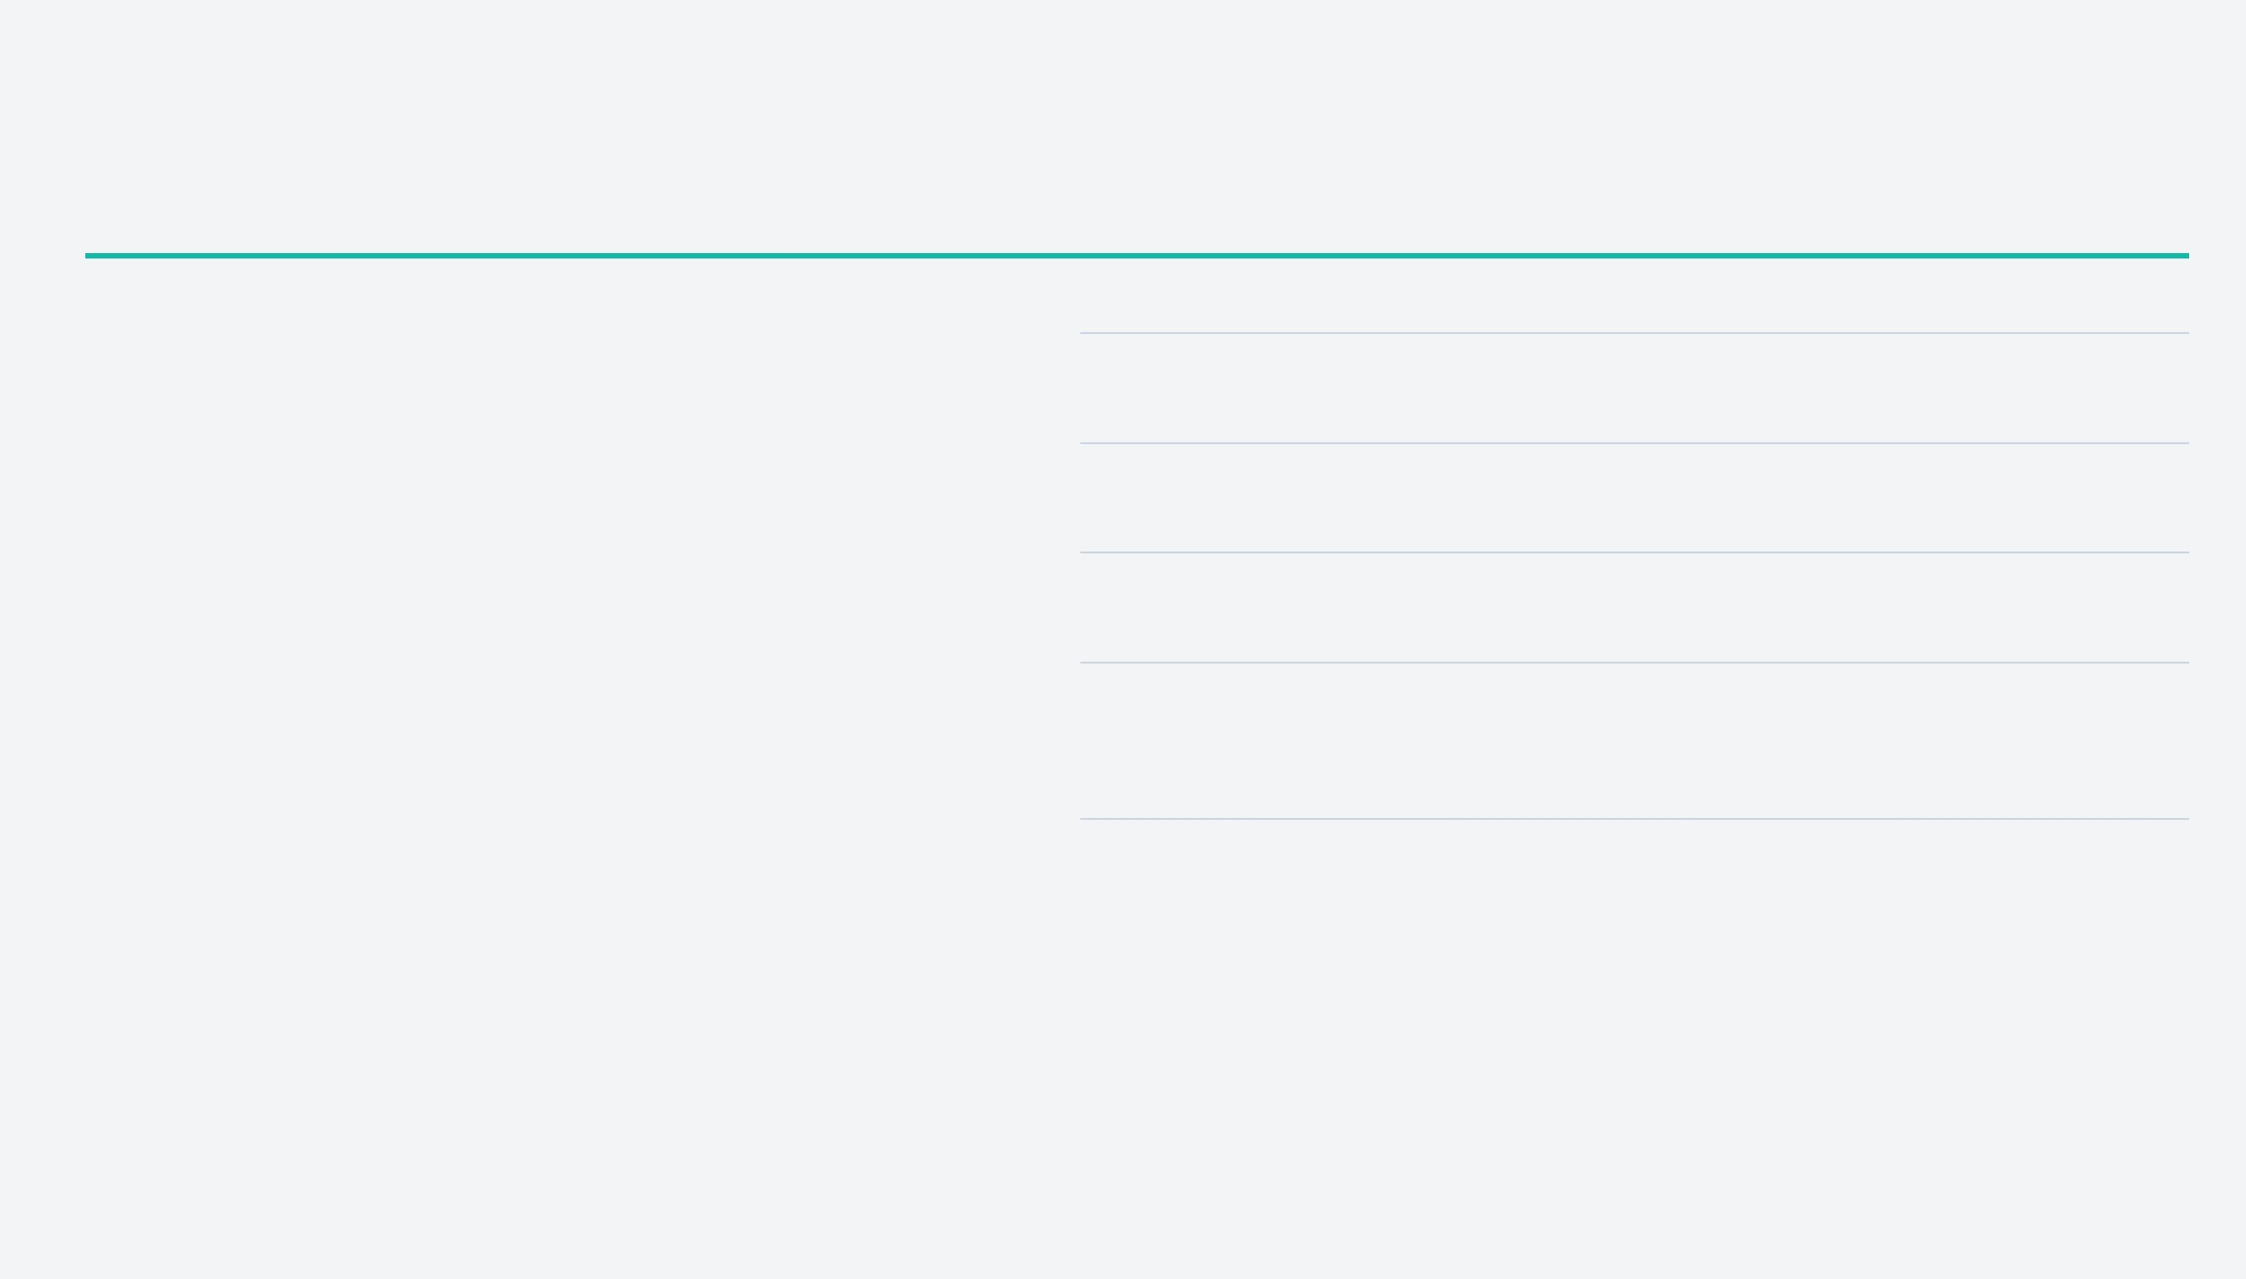
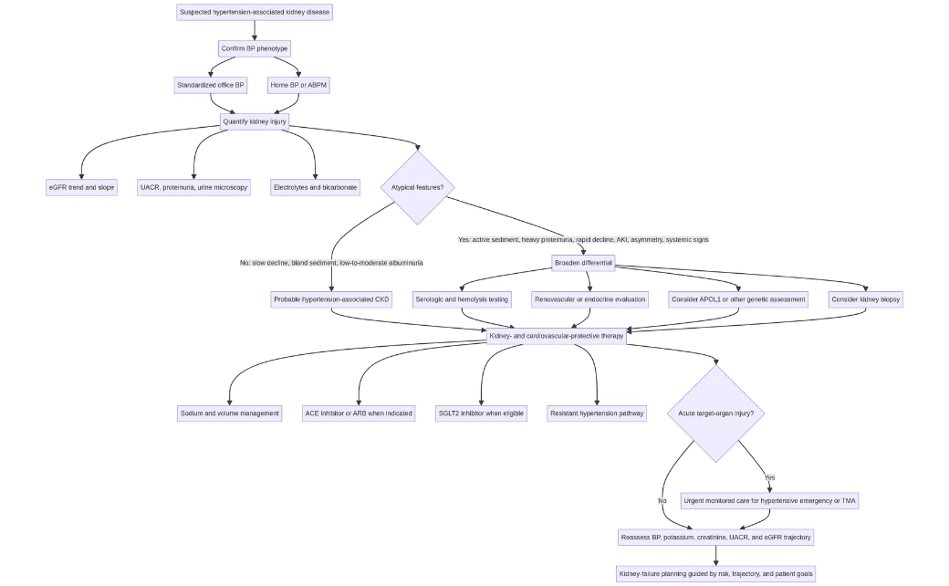
08 · RESIDENT CLOSE
The take-home algorithm
ON CALL, REMEMBER
01
Confirm the phenotype. Standardized office BP, home BP, or ABPM when needed.
02
Quantify kidney injury. UACR, sediment, eGFR trajectory, and structural assessment.
03
Challenge the label. Active sediment, heavy proteinuria, rapid decline, or systemic clues require a broader differential.
04
Protect the kidney. Sodium and volume control, RAAS blockade when indicated, SGLT2 therapy when eligible, and risk reduction.
05
Plan ahead. Recognize emergencies and begin kidney-failure planning before crisis dialysis.
Phenotype-first: confirm BP pattern, identify kidney injury, escalate if atypical.
Treat the patient in front of you — not the diagnostic label.
Sources: KDIGO 2021 BP in CKD · KDIGO 2024 CKD Evaluation and Management · Kidney Failure Risk Equation

